Slide 1




JusticeFlow AI
Intelligent Decision Support Pipeline
Spatial Clustering, Predictive Priority, and Optimal Workload Assignment
Presented by: Muhammad Furqan, Muhammad Abu Bakar, and Abdullah Muaz Abbasi
POSTGRESQL
PYTHON (SCIKIT-LEARN/SCIPY)
C++

Slide 2

The Core Problem
No Real-Time Crime Visibility
Police lack real-time visibility into emerging crime zones, making proactive deployment nearly impossible.
Uniform Case Treatment
Every FIR is treated equally, delaying justice for critical cases that demand immediate attention.
Manual Case Assignment
Case assignment is manual, leading to officer burnout and skill mismatch across the force.
"A modern police force cannot operate reactively. We built three distinct AI agents to answer three questions: Where are crimes happening? Which cases are most urgent? And who is the best officer to solve them?"

Slide 3


Agent 1 — Crime Hotspot Analyzer
DBSCAN · UNSUPERVISED LEARNING
How It Works
Algorithm: Unsupervised Learning (DBSCAN)
Features: incident_lat, incident_lon over the last 6 months
Why DBSCAN?
Unlike K-Means, DBSCAN doesn't force us to guess the number of hotspots (K). It finds dense geographical clusters of crime naturally and ignores isolated "noise" incidents.
"Our first agent scans the public database for recent crime coordinates. It identifies dense geographic clusters so the SHO knows exactly where to deploy active patrol units today."

Slide 4


Agent 2 — Case Priority Recommender
RANDOM FOREST · SUPERVISED LEARNING
How It Works
Algorithm: Supervised Learning (Random Forest Classifier)
Features: case_type (Label Encoded) and station_id
Output: Predicts if a new FIR should be HIGH or MEDIUM priority
Why Random Forest?
Random Forest prevents overfitting and gives us high accuracy (80%+) to instantly flag urgent cases for the Station Commander.
"When a new FIR is registered, this agent evaluates it against historical resolution data."

Slide 5
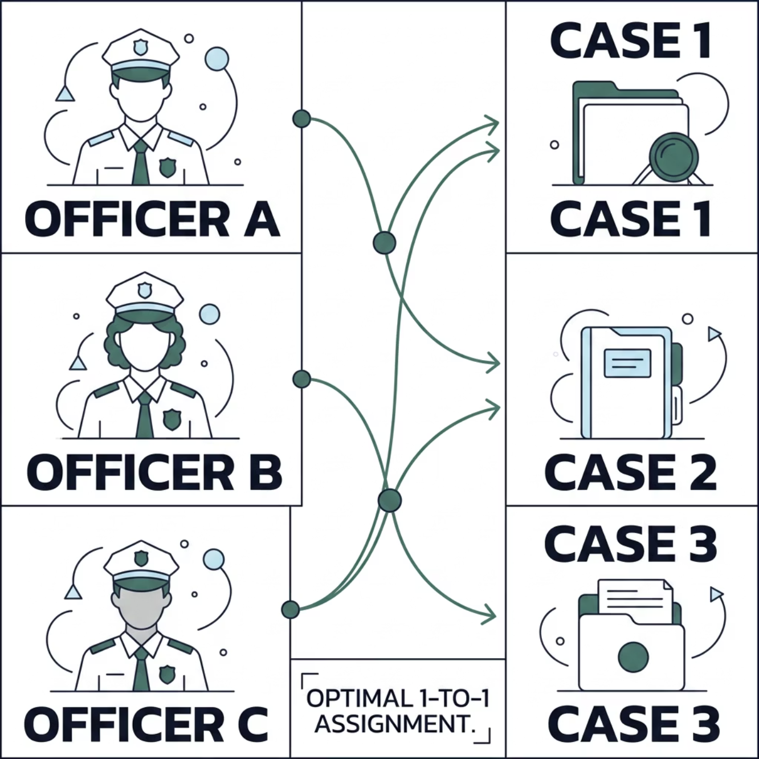

Agent 3 — Officer Workload Balancer
HUNGARIAN ALGORITHM · BIPARTITE MATCHING
Algorithm: Bipartite Matching Optimization
The Hungarian Algorithm delivers a mathematically optimal distribution of cases to officers in O(n^3) time — ensuring no officer is overloaded while every case is assigned to the most suitable person available.
Optimal
Efficient
Guaranteed minimum total cost
Polynomial time complexity

Slide 6
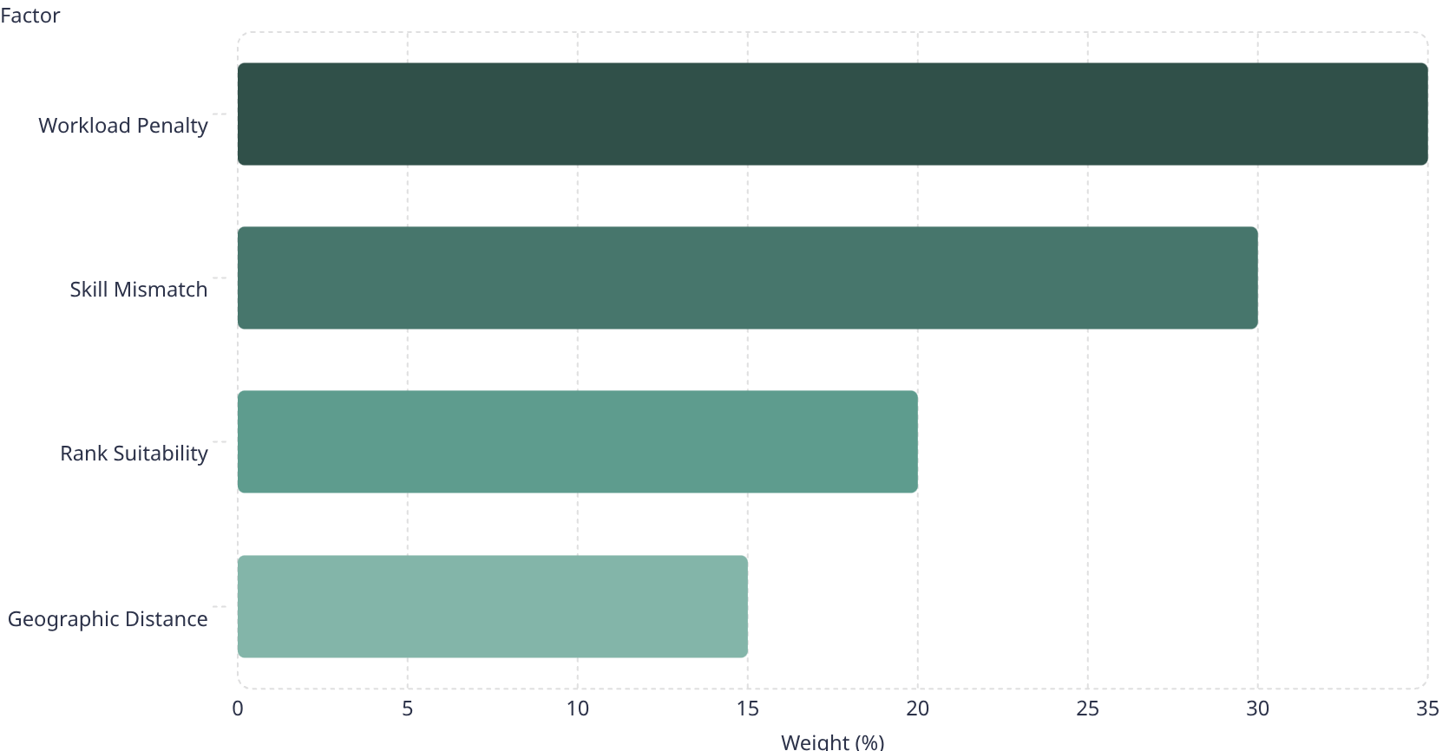
The Cost Matrix
The Hungarian algorithm is only as good as its inputs. We engineered a strict Cost Matrix — heavily penalising overworked officers to force the algorithm to find less-busy alternatives.
Workload Penalty — 35%
Skill Mismatch — 30%
Matches crime type to officer qualifications for better outcomes.
Exponential penalty for overworked officers. Assigning a 10th case carries a steep cost.
Rank Suitability — 20%
Geographic Distance — 15%
Enforces minimum CrPC rank required for severe crimes.
Haversine distance from station to crime scene.

Slide 7




Cross-Course Architecture
These aren't just Jupyter Notebook scripts. They are production-grade OS processes — the Python AI packs its own telemetry into raw C-bytes and transmits it via POSIX FIFO pipes so the C++ backend can read it in real-time.
DB Security
OS Isolation
Agents read from public tables but INSERT only to the analytics schema — no data corruption risk to operational records.
Agents run as isolated child processes spawned via fork() + exec(), ensuring complete runtime separation.
IPC Telemetry
Agents compress status into C-bytes (struct.pack) and transmit via POSIX Named Pipes (os.O_NONBLOCK) for real-time reads.

Slide 8




Conclusion
AI Suggests. SHO Decides.
JusticeFlow AI delivers data-driven policing without replacing human authority. Three intelligent agents — spatial clustering, predictive priority, and optimal workload assignment — work in concert to give Station House Officers the clarity and confidence to act decisively.
Where?
Hotspot zones identified
What Priority?
Cases flagged instantly
Who?
Best officer assigned

Slide 9




Thank You
We welcome your questions and feedback.
Muhammad Furqan
Muhammad Abu Bakar
Abdullah Muaz Abbasi
POSTGRESQL
PYTHON
C++

